Slide 1

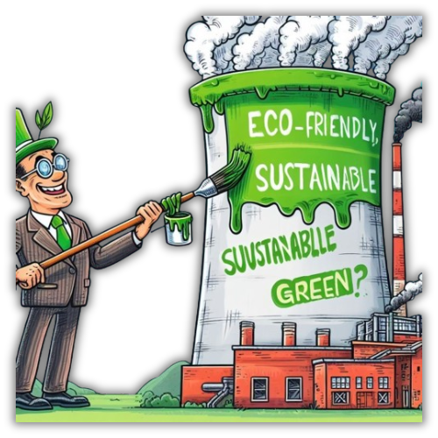
Greenwashing
Business implications and Consequences

Slide 2
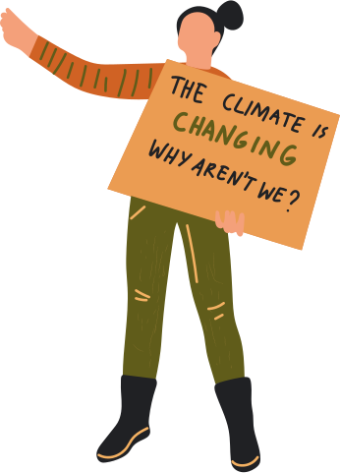

List of Contents
Introduction about Greenwashing
Research Questions
Methodology
Finding: Case Studies
Conclusion
1
2
3
4
5

Slide 3
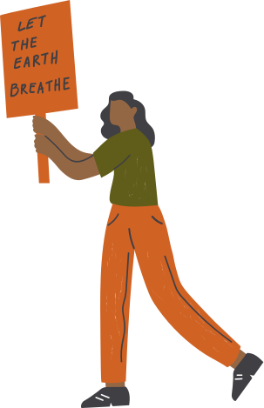


Introduction
What is greenwashing?
Types of Greenwashing
Decoupling
Attention deflection

Slide 4


Research Questions
What are the consequences of a company Greenwashing?
If Greenwashing is a strategy which the companies use does it work?
Business implications of a company which was caught practicing greenwashing.

Slide 5


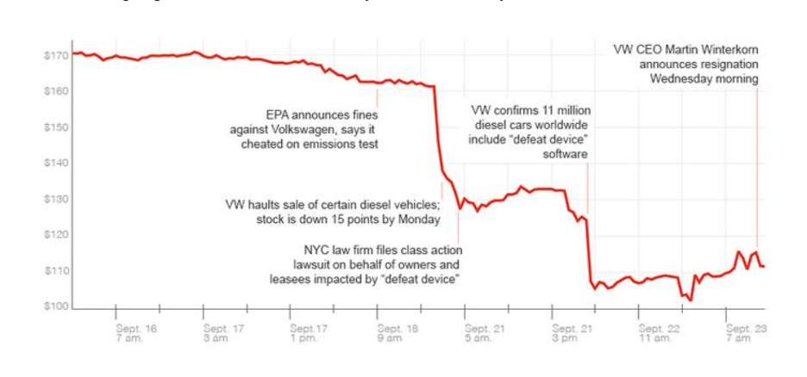



Volkswagen
Scandal came out in 2014
Defeat device installed
Company was fined $30 billion
Company made several changes to its working
Deceptive manipulation technique

Slide 6




Ryanair
Accused of greenwashing by Advertising Standard Authority
“Europes lowest fairs, lowest emission Airline”
Fly greener
Consequences for this action by the company

Slide 7


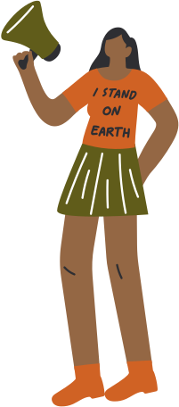
Starbucks
In 2018, Starbucks took an initiative to remove plastic straws.
Introduced straw less lids
New lids are made from a thicker type of plastic than the original combination
Harsh reality is that only about 9% of all plastic is recycled worldwide
Focus on recyclability, overshadows the more critical need to reduce plastic

Slide 8
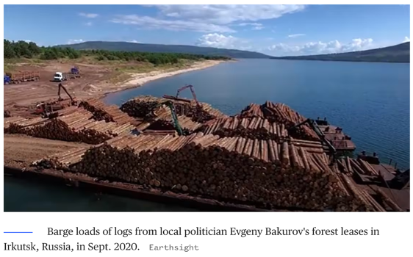

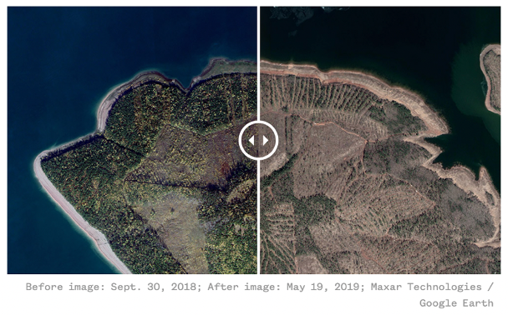

Ikea has practiced a selective and inaccurate disclosure strategy.
Ikea is linked to illegal logging activities in Russia’s protected boreal forests.
Bakurov’s enterprises have been implicated in harvesting approximately 2.16 million cubic meters of wood from protected forests.
Ikea denied any wrongdoing and stated that the wood was “legally harvested”.

Slide 9
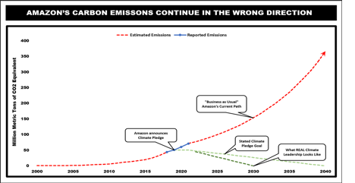


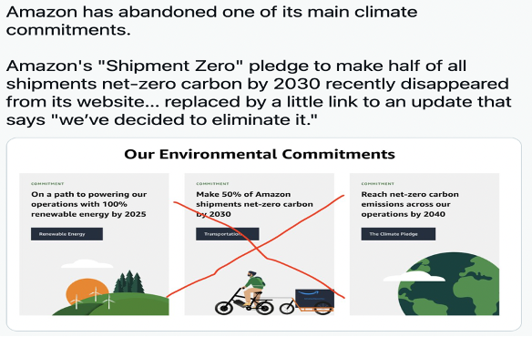
Amazon employees filed a resolution in December 2018
Launched Shipment zero program to reduce carbon emissions
Amazon promised to achieve Net carbon zero by 2040
Company silently cancelled the shipment zero program
Carbon emissions have alarmingly elevated by using 40%

Slide 10
Conclusion
1
Consequences for a company Greenwashing
2
Business implications of a company which was caught practicing greenwashing
3
Greenwashing as a strategy and does it work?

Slide 11

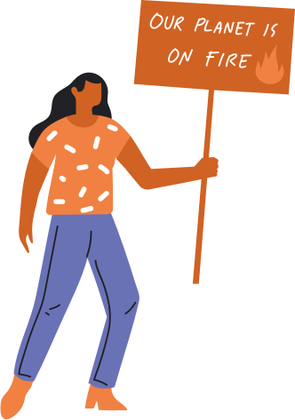

Thank You

